Slide 1
Options on
Stock Indices, Currencies, and Futures
Chapters 16/17
16.<number>

Slide 2
European Options on Stocks
Providing a Dividend Yield
16.<number>
We get the same probability distribution for the stock price at time T in each of the following cases:
1. The stock starts at price S₀ and provides a dividend yield = q
2. The stock starts at price S₀e^{–q T} and provides no income

Slide 3
European Options on Stocks
Providing Dividend Yield continued
16.<number>
We can value European options by reducing the stock price to S₀e^{–q T} and then behaving as though there is no dividend

Slide 4
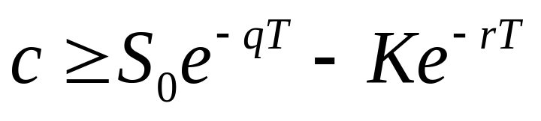
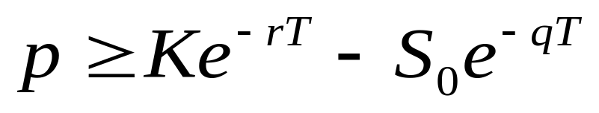
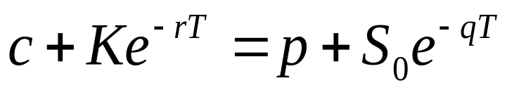
Extension of Chapter 9 Results
(Equations 15.1 to 15.3)
16.<number>
Lower Bound for calls:
Lower Bound for puts
Put Call Parity

Slide 5
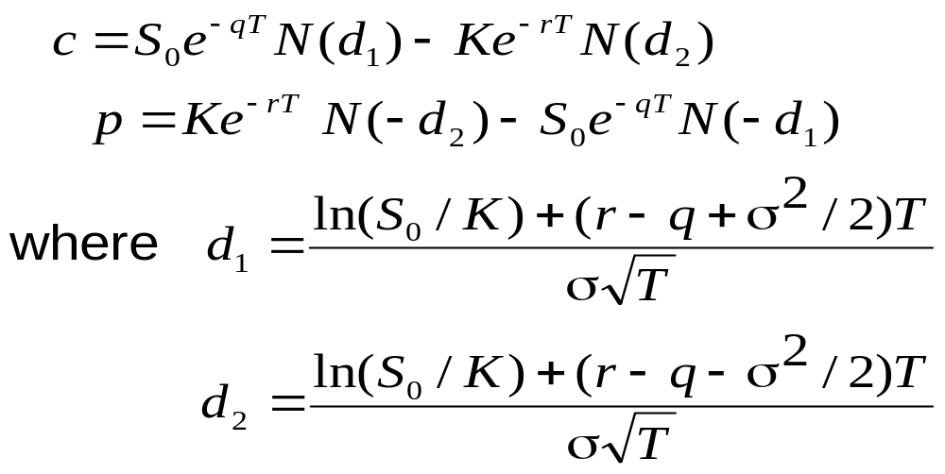
Extension of Chapter 13 Results (Equations 15.4 and 15.5)
16.<number>

Slide 6
The Binomial Model
16.<number>
S₀u
ƒ_{u}
p
S₀
ƒ
S₀d
ƒ_{d}
(1 – p )
        f=e^{-rT}[pf_{u}+(1-p)f_{d} ]

Slide 7
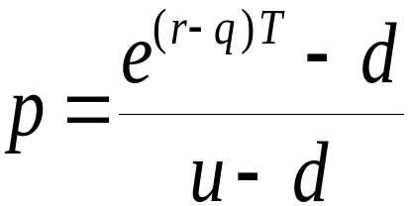
The Binomial Model continued
16.<number>
In a risk-neutral world the stock price grows at r-q rather than at r when there is a dividend yield at rate q
The probability, p, of an up movement must therefore satisfy
pS₀u+(1-p)S₀d=S₀e ^{(r-q)T}
so that

Slide 8
Index Options
16.<number>
Option contracts are on 100 times the index
The most popular underlying indices are
  the Dow Jones Industrial (European) DJX
  the S&P 100 (American) OEX
  the S&P 500 (European) SPX
Contracts are settled in cash

Slide 9
Index Option Example
16.<number>
Consider a call option on an index with a strike price of 560
Suppose 1 contract is exercised when the index level is 580
What is the payoff?

Slide 10
Using Index Options for Portfolio Insurance
16.<number>
Suppose the value of the index is S₀ and the strike price is K
If a portfolio has a β of 1.0, the portfolio insurance is obtained by buying 1 put option contract on the index for each 100S₀ dollars held
If the β is not 1.0, the portfolio manager buys β put options for each 100S₀ dollars held
In both cases, K is chosen to give the appropriate insurance level

Slide 11
Example 1
16.<number>
Portfolio has a beta of 1.0
It is currently worth $500,000
The index currently stands at 1000
What trade is necessary to provide insurance against the portfolio value falling below $450,000?

Slide 12
Example 2
16.<number>
Portfolio has a beta of 2.0
It is currently worth $500,000 and index stands at 1000
The risk-free rate is 12% per annum
The dividend yield on both the portfolio and the index is 4%
How many put option contracts should be purchased for portfolio insurance?

Slide 13
Calculating Relation Between Index Level and Portfolio Value in 3 months
16.<number>
If index rises to 1040, it provides a 40/1000 or 4% return in 3 months
Total return (incl dividends)=5%
Excess return over risk-free rate=2%
Excess return for portfolio=4%
Increase in Portfolio Value=4+3-1=6%
Portfolio value=$530,000

Slide 14
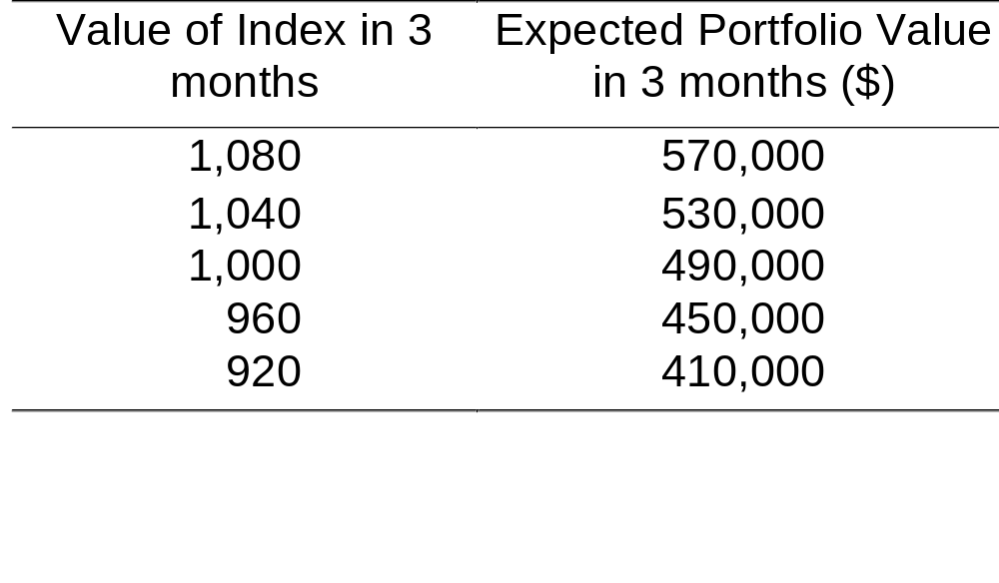
Determining the Strike Price (Table 15.2, page 327)
16.<number>
An option with a strike price of 960 will provide protection against a 10% decline in the portfolio value

Slide 15
Valuing European Index Options
16.<number>
We can use the formula for an option on a stock paying a dividend yield
Set S₀ = current index level
Set q = average dividend yield expected during the life of the option

Slide 16
Currency Options
16.<number>
Currency options trade on the Philadelphia Exchange (PHLX)
There also exists an active over-the-counter (OTC) market
Currency options are used by corporations to buy insurance when they have an FX exposure

Slide 17
The Foreign Interest Rate
16.<number>
We denote the foreign interest rate by r_{f}
When a U.S. company buys one unit of the foreign currency it has an investment of S₀ dollars
The return from investing at the foreign rate is r_{f} S₀ dollars
This shows that the foreign currency provides a “dividend yield” at rate r_{f}

Slide 18
Valuing European Currency Options
16.<number>
A foreign currency is an asset that provides a “dividend yield” equal to r_{f}
We can use the formula for an option on a stock paying a dividend yield :
    Set S₀ = current exchange rate
    Set q = r_{ƒ}

Slide 19
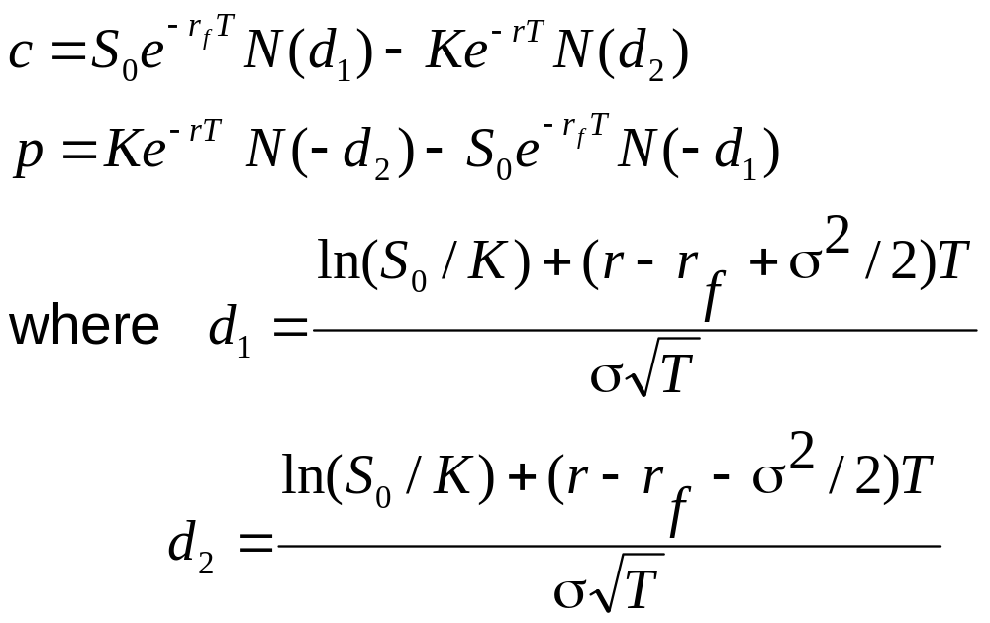
Formulas for European Currency Options
(Equations 15.11 and 15.12, page 335)
16.<number>

Slide 20
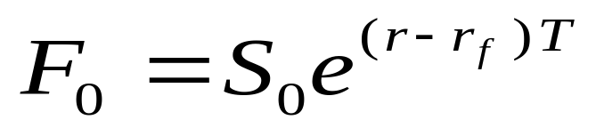
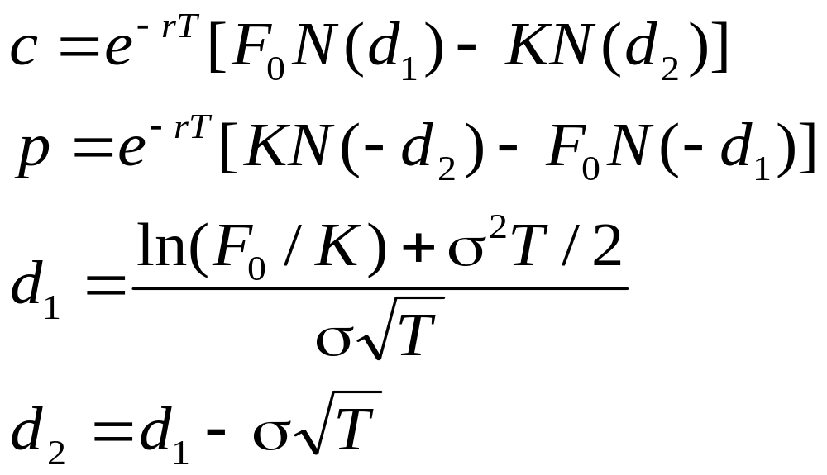
Alternative Formulas
(Equations 15.13 and 15.14, page 336)
16.<number>
Using

Slide 21
Mechanics of Call Futures Options
16.<number>
When a call futures option is exercised the holder acquires
1. A long position in the futures
2. A cash amount equal to the excess of
the futures price over the strike price

Slide 22
Mechanics of Put Futures Option
16.<number>
When a put futures option is exercised the holder acquires
1. A short position in the futures
2. A cash amount equal to the excess of
the strike price over the futures price

Slide 23
The Payoffs
16.<number>
If the futures position is closed out immediately:
Payoff from call = F₀ – K
Payoff from put = K – F₀
where F₀ is futures price at time of exercise

Slide 24
Put-Call Parity for Futures Options (Equation 16.1, page 345)
16.<number>
Consider the following two portfolios:
1. European call plus Ke^{-rT} of cash
2. European put plus long futures plus cash equal to F₀e^{-rT}
They must be worth the same at time T so that
c+Ke^{-rT}=p+F₀ e^{-rT}

Slide 25
Binomial Tree Example
16.<number>
A 1-month call option on futures has a strike price of 29.
Futures Price = $33
Option Price = $4
Futures price = $30
Option Price=?
Futures Price = $28
Option Price = $0

Slide 26
Setting Up a Riskless Portfolio
16.<number>
Consider the Portfolio: long Δ futures short 1 call option
Portfolio is riskless when 3Δ – 4 = -2Δ or Δ = 0.8
3Δ – 4
-2Δ

Slide 27
Valuing the Portfolio
( Risk-Free Rate is 6% )
16.<number>
The riskless portfolio is:
long 0.8 futures short 1 call option
The value of the portfolio in 1 month is -1.6
The value of the portfolio today is -1.6e ^{– 0.06/12} = -1.592

Slide 28
Valuing the Option
16.<number>
The portfolio that is
long 0.8 futures short 1 option
is worth -1.592
The value of the futures is zero
The value of the option must therefore be 1.592

Slide 29
Generalization of Binomial Tree Example (Figure 16.2, page 348)
16.<number>
A derivative lasts for time T and is dependent on a futures price
F₀u
ƒ_{u}
F₀
ƒ
F₀d
ƒ_{d}

Slide 30
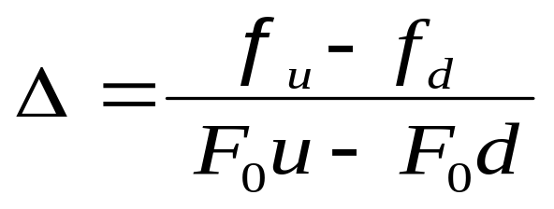
Generalization
(continued)
16.<number>
Consider the portfolio that is long Δ futures and short 1 derivative
The portfolio is riskless when
F₀u Δ − F₀ Δ – ƒ_{u}
F₀d Δ− F₀Δ – ƒ_{d}

Slide 31
Generalization
(continued)
16.<number>
Value of the portfolio at time T is F₀u Δ –F₀Δ – ƒ_{u}
Value of portfolio today is – ƒ
Hence ƒ = – [F₀u Δ –F₀Δ – ƒ_{u}]e^{-rT}

Slide 32
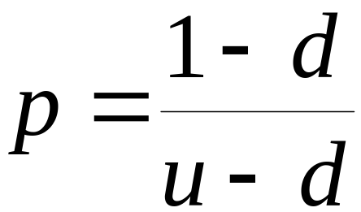
Generalization
(continued)
16.<number>
Substituting for Δ we obtain
ƒ = [ p ƒ_{u} + (1 – p )ƒ_{d} ]e^{–rT}
where

Slide 33
Valuing European Futures Options
16.<number>
We can use the formula for an option on a stock paying a dividend yield
    Set S₀ = current futures price (F₀)
    Set q = domestic risk-free rate (r )
Setting q = r ensures that the expected growth of F in a risk-neutral world is zero

Slide 34
Growth Rates For Futures Prices
16.<number>
A futures contract requires no initial investment
In a risk-neutral world the expected return should be zero
The expected growth rate of the futures price is therefore zero
The futures price can therefore be treated like a stock paying a dividend yield of r

Slide 35
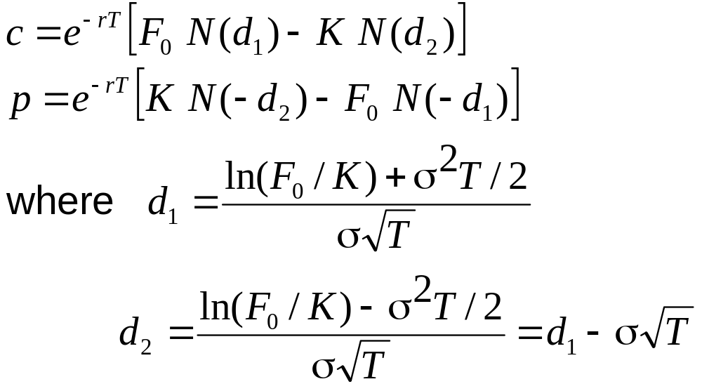
Black’s Formula
(Equations 16.9 and 16.10, page 350)
16.<number>
The formulas for European options on futures are known as Black’s formulas

Slide 36
Futures Option Prices vs Spot Option Prices
16.<number>
If futures prices are higher than spot prices (normal market), an American call on futures is worth more than a similar American call on spot. An American put on futures is worth less than a similar American put on spot
When futures prices are lower than spot prices (inverted market) the reverse is true

Slide 37
Summary of Key Results
16.<number>
We can treat stock indices, currencies, and futures like a stock paying a dividend yield of q
  For stock indices, q = average dividend yield on the index over the option life
  For currencies, q = r_{ƒ}
  For futures, q = r

